Slide 1
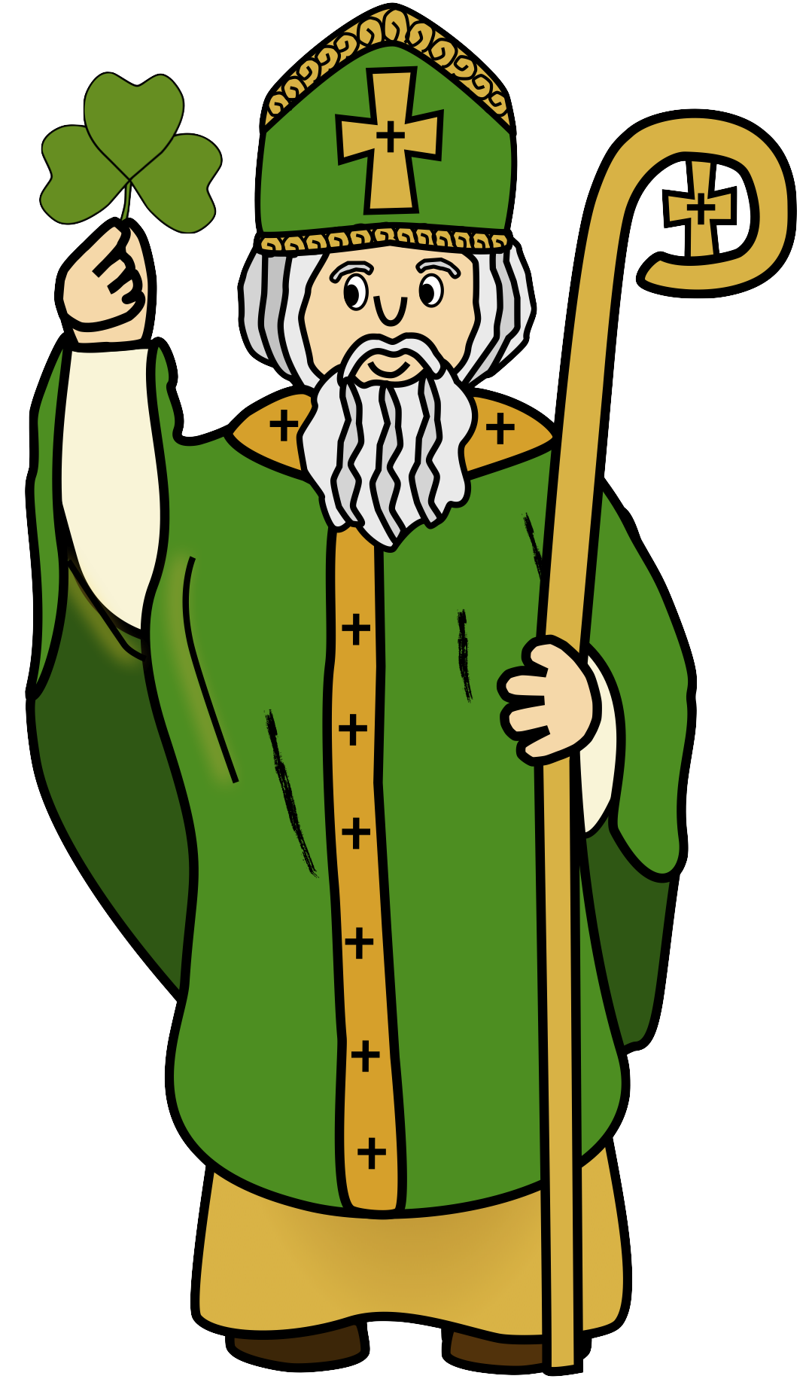
The Story of
St. Patrick

Slide 2
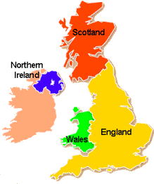
Childhood
St Patrick was born in Wales in 387.
He was captured by pirates when he was about 14 years old and was taken to Ireland. He was sold to a farmer in Antrim to work as a slave.
He looked after sheep on a hill for him.

Slide 3
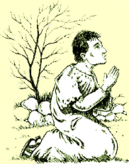
God
The farmer wasn’t very nice to Patrick.
He prayed every night to God and one night he heard a voice.
God was telling him he must escape.
He then escaped when he was 20 years old and went back to Wales with sailors to his family.

Slide 4
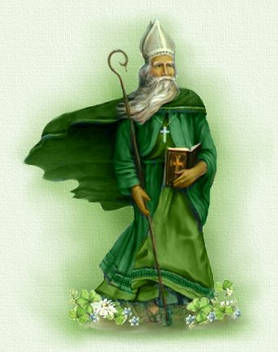
Escape
Once he escaped the voice came back and told him to go back to Ireland to spread the word and the story of Jesus.
When he started telling the stories he realised he wanted to be a pries.
This was going to be hard and he first went to St. Martins Monastery in Tours, France.

Slide 5
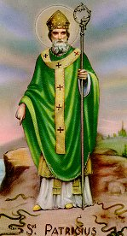
Return
After he returned to Ireland as a priest and everyone was shocked that he could speak their language.
He also banished snakes from Ireland.
He stood on a hilltop and waved his staff sending all snakes into the sea and away from Ireland.

Slide 6
The Shamrock
He continued to tell stories of Jesus and used the shamrock to explain the trinity-the father and the son and the holy spirt all combined together.

Slide 7
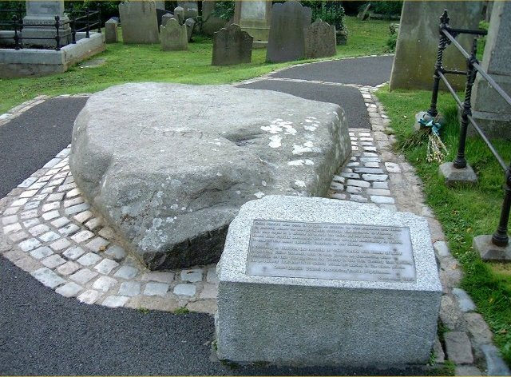
Death
St. Patrick spent 60 years in Ireland and died in Sabhall, Co. Down on the 17th March 461.
He was 76 years old when he died.
He is now buried in Co. Down.

